Slide 2
“When getting help with money, whether it’s insurance, real estate or investments, you should always look for someone with the heart of a teacher, not the heart of a salesman.”
- Dave Ramsey

Slide 3
Mortgage Rates
The Last 12 Months
Freddie Mac 30-Year Fixed Rate
2.65%
Freddie Mac
Notes:
http://www.freddiemac.com/pmms
http://www.freddiemac.com/pmms/pmms_archives.html

Slide 4
“One in five people who moved within the past year cited “remote working” as the reason they moved.”
- Forbes
Notes:
https://www.forbes.com/sites/bradhunter/2020/12/12/homebuilders-take-note-45-say-they-would-move-if-they-could-work-remotely/?sh=2b4ef3883e9f

Slide 5
Year-Over-Year Change in Listings
move.com
Notes:
https://www.realtor.com/research/weekly-housing-trends-view-data-week-dec-12-2020/

Slide 6
4 TRENDS THAT WILL BE THE KEY TO LISTING SUCCESS IN 2021
Consumers are re-evaluating home
Remote work has changed where people choose to live
New Construction gives sellers the ability to design their home
Low Mortgage rates make moving up a no brainer

Slide 7
“We asked homeowners whether COVID-19 and the time at home has caused them to notice more issues, imperfections, or areas in need of maintenance or improvement in their homes. Nearly 64% said yes.”
Home Advisor
Notes:
https://www.homeadvisor.com/r/wp-content/uploads/2020/12/DP6355-StateOfHomeSpending-2020-R4.pdf

Slide 8
Transaction Forecasts
Forecast | 2020 | 2021
Fannie Mae | 6.48M | 6.66M
NAR | 6.34M | 7.06M
MBA | 6.42M | 7.17M
Notes:
https://www.fanniemae.com/media/37541/display
http://www.freddiemac.com/fmac-resources/research/pdf/202010-Forecast-03.pdf
http://zillow.mediaroom.com/2020-12-18-Home-Value-Growth-Breaks-Records-as-Rents-Stabilize
www.redfin.com/news/housing-market-predictions-2021/
https://www.mba.org/news-research-and-resources/research-and-economics/forecasts-and-commentary
https://cdn.nar.realtor/sites/default/files/documents/forecast-Q3-2020-us-economic-outlook-0-11-17-2020.pdf

Slide 9
Vacation Budget Spent On Home Services
40%
27%
More Home
Entertaining
More Outdoor Living
2020 State Of Home Spending Report
Notes:
https://www.homeadvisor.com/r/wp-content/uploads/2020/12/DP6355-StateOfHomeSpending-2020-R4.pdf

Slide 10
“Demand is still at unprecedented levels. With inventory continuing to be at historic lows across the U.S., we are likely to see this elevated level of demand into next year’s busy season.”- Daniil Cherkasskiy, ShowingTime Chief Analytics Officer
Year-Over-Year Increase in Showing Activity
Notes:
https://www.showingtime.com/blog/november-2020-showing-index-results/

Slide 11
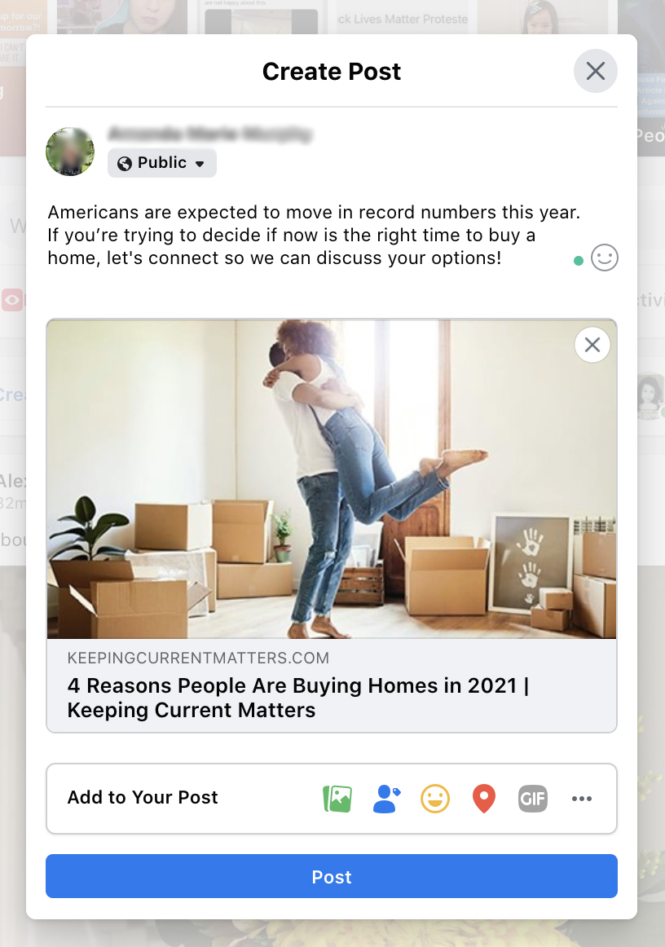
SHARE WITH YOUR CLIENTS
Share a KCM personalized blog about the topic you want to cover and use the Bottom Line as your post caption.
Blog Slide

Slide 12
4 TRENDS THAT WILL BE THE KEY TO LISTING SUCCESS IN 2021
Consumers are re-evaluating home
Remote work has changed where people choose to live
New Construction gives sellers the ability to design their home
Low Mortgage rates make moving up a no brainer

Slide 13
“The surge in the work-from-home population has rewritten the playbook for many homebuying and rental decisions, from when and where to relocate, to what people are looking for in their next residence…”
David Mele
President at Homes.com
Notes:
https://atlantaagentmagazine.com/2020/12/10/remote-workers-could-continue-to-drive-the-post-pandemic-market/

Slide 14
“Even partial persistence of work-from-home options will expand buyer purchasing options. NAHB data shows 61% of workers believe they’ll be able to telecommute on at least a partial basis after a vaccine is deployed. And while less than one-third of the workforce has been working at home, any reduction in traffic reduces the commute time/cost for all workers.”
Robert Dietz
Chief Economist and Senior VP for Economics and Housing Policy for NAHB
Notes:
https://www.builderonline.com/design/consumer-trends/how-increased-work-from-home-opportunities-benefit-the-housing-market_o?

Slide 15
Consensus View of Work From Home
Percent of workers working from home
2020 Panel Consensus Forecast
2020 NAR’s Real Estate Forecast Summit
Notes:
https://www.nar.realtor/events/nar-real-estate-forecast-summit

Slide 16
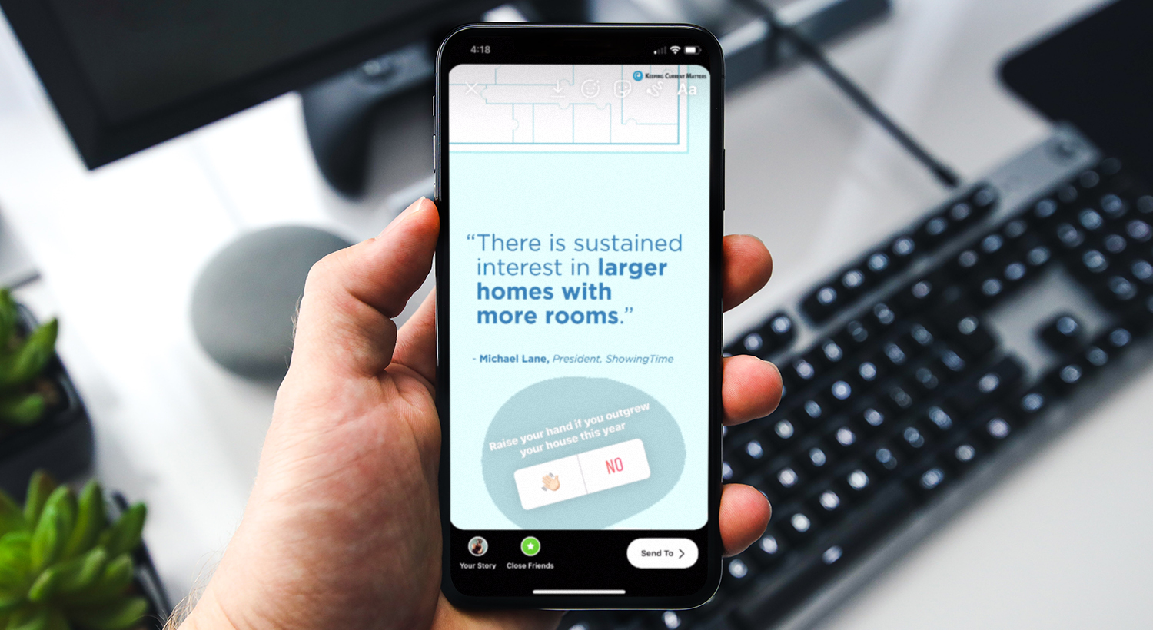

Slide 17
4 TRENDS THAT WILL BE THE KEY TO LISTING SUCCESS IN 2021
Consumers are re-evaluating home
Remote work has changed where people choose to live
New Construction gives sellers the ability to design their home
Low Mortgage rates make moving up a no brainer

Slide 18
“With 10,000 baby boomers turning 65 and migrating into retirement every day through 2030, their lifestyle choices strongly remain the second most powerful consumer economic force… As a result, retailers and home developers must adapt to the changing needs, desires, and demands of baby boomers for at least another decade.”
Realty Biz News
Notes:
https://realtybiznews.com/baby-boomers-downsizing-homes-but-upscaling-experiences-2/98759584/

Slide 19
PURCHASED A NEW HOME BECAUSE…
Percent of Respondents
2020 Profile of Home Buyers and Sellers Report
Notes:
https://www.nar.realtor/research-and-statistics/research-reports/highlights-from-the-profile-of-home-buyers-and-sellers

Slide 20
“New home sales activity, both mortgage applications and home sales, ran at a pace considerably ahead of 2019, showing the ongoing strong growth in housing demand and new residential construction.”
Joel Kan
MBA’s AVP of Economic and Industry Forecasting
Notes:
https://www.mba.org/2020-press-releases/december/november-new-home-purchase-mortgage-applications-increased-347-percent

Slide 21
Why New Homes Purchased
2020 NAR Home Buyer and Seller Generational Trends
Notes:
https://www.nar.realtor/sites/default/files/documents/2020-generational-trends-report-03-05-2020.pdf

Slide 22
“Home feature preferences have shifted substantially during the pandemic, with 78% of real estate professionals citing client requests for home offices as the #1 change followed by larger square footage (57%), outdoor recreational spaces such as pools, hot tubs and decks (45%) and upgraded kitchens (44%). These adjustments illustrate the effect of today’s work-from-home and e-learning needs on creating a practical and comfortable living environment.”
Homes.com
Notes:
https://press.homes.com/pandemic-reshapes-homebuying-rental-decisions-homes-com-survey/

Slide 23
4 TRENDS THAT WILL BE THE KEY TO LISTING SUCCESS IN 2021
Consumers are re-evaluating home
Remote work has changed where people choose to live
New Construction gives sellers the ability to design their home
Low Mortgage rates make moving up a no brainer

Slide 24
“Housing affordability, which had greatly benefitted from falling mortgage rates, are now being challenged due to record-high home prices… That could place strain on some potential consumers, particularly first-time buyers.”
Lawrence Yun
Chief Economist at NAR
Notes:
https://www.nar.realtor/newsroom/existing-home-sales-decrease-2-5-in-november

Slide 25
Mortgage Rates
Freddie Mac
30-Year Fixed Rate
2019
- Actual
- Projected
2018
2017
2020
2016
2021
Freddie Mac
Notes:
http://www.freddiemac.com/research/forecast/20201014_quarterly_economic_forecast.page?

Slide 26
Date | Mortgage | Interest Rate | P&I*
Today | $300,000 | 2.7% | $1,216.79
2021 4Q | $317,100** | 3.4%** | $1,406
 |  |  | $189.21
 |  |  | $68,115.60
Difference in Monthly Payment
The difference in the life of the loan (30 Yrs.)
*Principal and Interest Payment
** 2021 Mortgage Rate and Home Price
increase of 5.7% forecasted by realtor.com
Notes:
http://www.freddiemac.com/fmac-resources/research/pdf/202010-Forecast-03.pdf
https://news.move.com/2020-12-02-Realtor-com-R-2021-Housing-Forecast-Sellers-Will-Get-Top-Dollar-As-Buyers-Struggle-with-Affordabilityhttps://www.mortgagecalculator.net/

Slide 27
“If you’ve found a home that fits your needs at a price you can afford, it might be better to act now rather than wait for future rate declines that may never come and a future that likely holds very tight inventory.”
Len Keifer,
Deputy Chief Economist for Freddie Mac
Notes:
https://www.bankrate.com/mortgages/mortgage-rate-forecast-for-january-2021/

Slide 28
$54,221
potential growth in household wealth over the next five years based solely on increased home equity
if you purchase a $300K home in January 2021
Based on price appreciation projected by the Home Price Expectation Survey
Home Price Expectation Survey 2020 4Q
Notes:
https://pulsenomics.com/surveys/#home-price-expectations

Slide 29
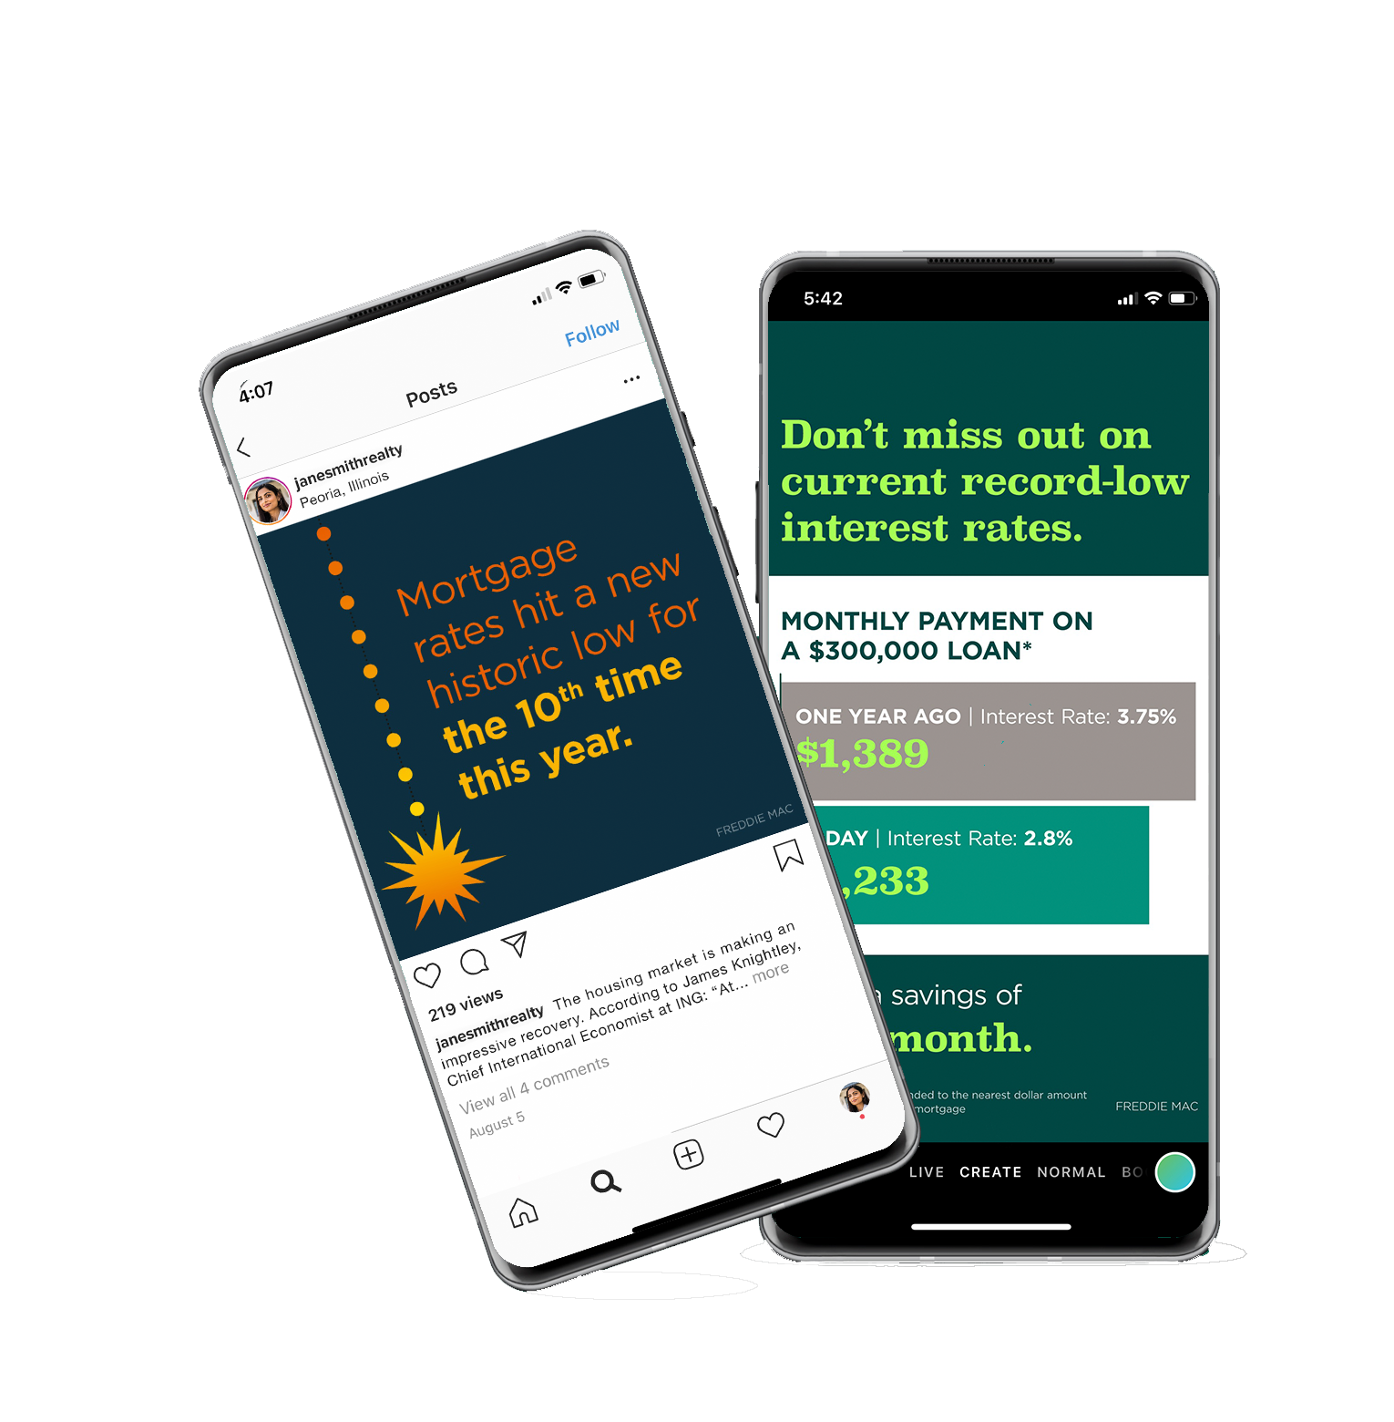
SHARE WITH YOUR CLIENTS
Highlight low mortgage rates with a KCM social media graphic for your Instagram feed or story.
Blog Slide

Slide 30
4 TRENDS THAT WILL BE THE KEY TO LISTING SUCCESS IN 2021
Consumers are re-evaluating home
Remote work has changed where people choose to live
New Construction gives sellers the ability to design their home
Low Mortgage rates make moving up a no brainer
**HOW FORBEARANCE WILL IMPACT LISTINGS IN 2021

Slide 31
For each of the following possible post-forbearance outcomes, what percentage of these 2.7 million homeowners do you estimate will...
18%
Receive a foreclosure
notice within 1 year
of exiting forbearance
58%
(486K)
24%
Resume their mortgage payments and stay in their home for at least 1 year
List their home within
1 year of exiting forbearance
(1.57M)
(648K)
Home Price Expectation Survey 2020 4Q
Notes:
https://pulsenomics.com/surveys/#home-price-expectations

Slide 32
“The housing market performed remarkably well in 2020 despite the volatile economic state. While we can expect to see lingering effects of COVID-19 resurgences and subsequent shutdowns in the early months of 2021, vaccine distributions and stimulus actions should revitalize economic activity and keep home purchase demand and home price growth strong.”
Frank Martell
President and CEO of CoreLogic
Notes:
https://www.corelogic.com/insights-download/home-price-index.aspx

