Slide 1
Showings in North America
Weekly showings normalized to the first calendar week of January, 7-day moving average.
ShowingTime
Notes:
https://www.showingtime.com/impact-of-coronavirus/

Slide 2
Purchase Applications
Year-Over-Year Difference
14 straight weeks of Y-O-Y increases
seasonally adjusted
MBA
Notes:
https://www.mba.org/news-research-and-resources/newsroom

Slide 3
“Those shopping for a home can afford 10 percent more home than they could have one year ago while keeping their monthly payment unchanged. This translates into nearly $32,000 more buying power.”
Black Knight/Mortgage News Daily
Notes:
http://www.mortgagenewsdaily.com/08032020_black_knight_mortgage_monitor.asp

Slide 4
“Although housing prices have consistently moved higher, when the favorable mortgage rates are factored in, an overall home purchase was more affordable in 2020’s second quarter compared to one year ago.”
Lawrence Yun
Chief Economist at NAR
Notes:
https://www.nar.realtor/newsroom/metro-home-prices-grow-in-96-of-metro-areas-in-second-quarter-of-2020

Slide 5
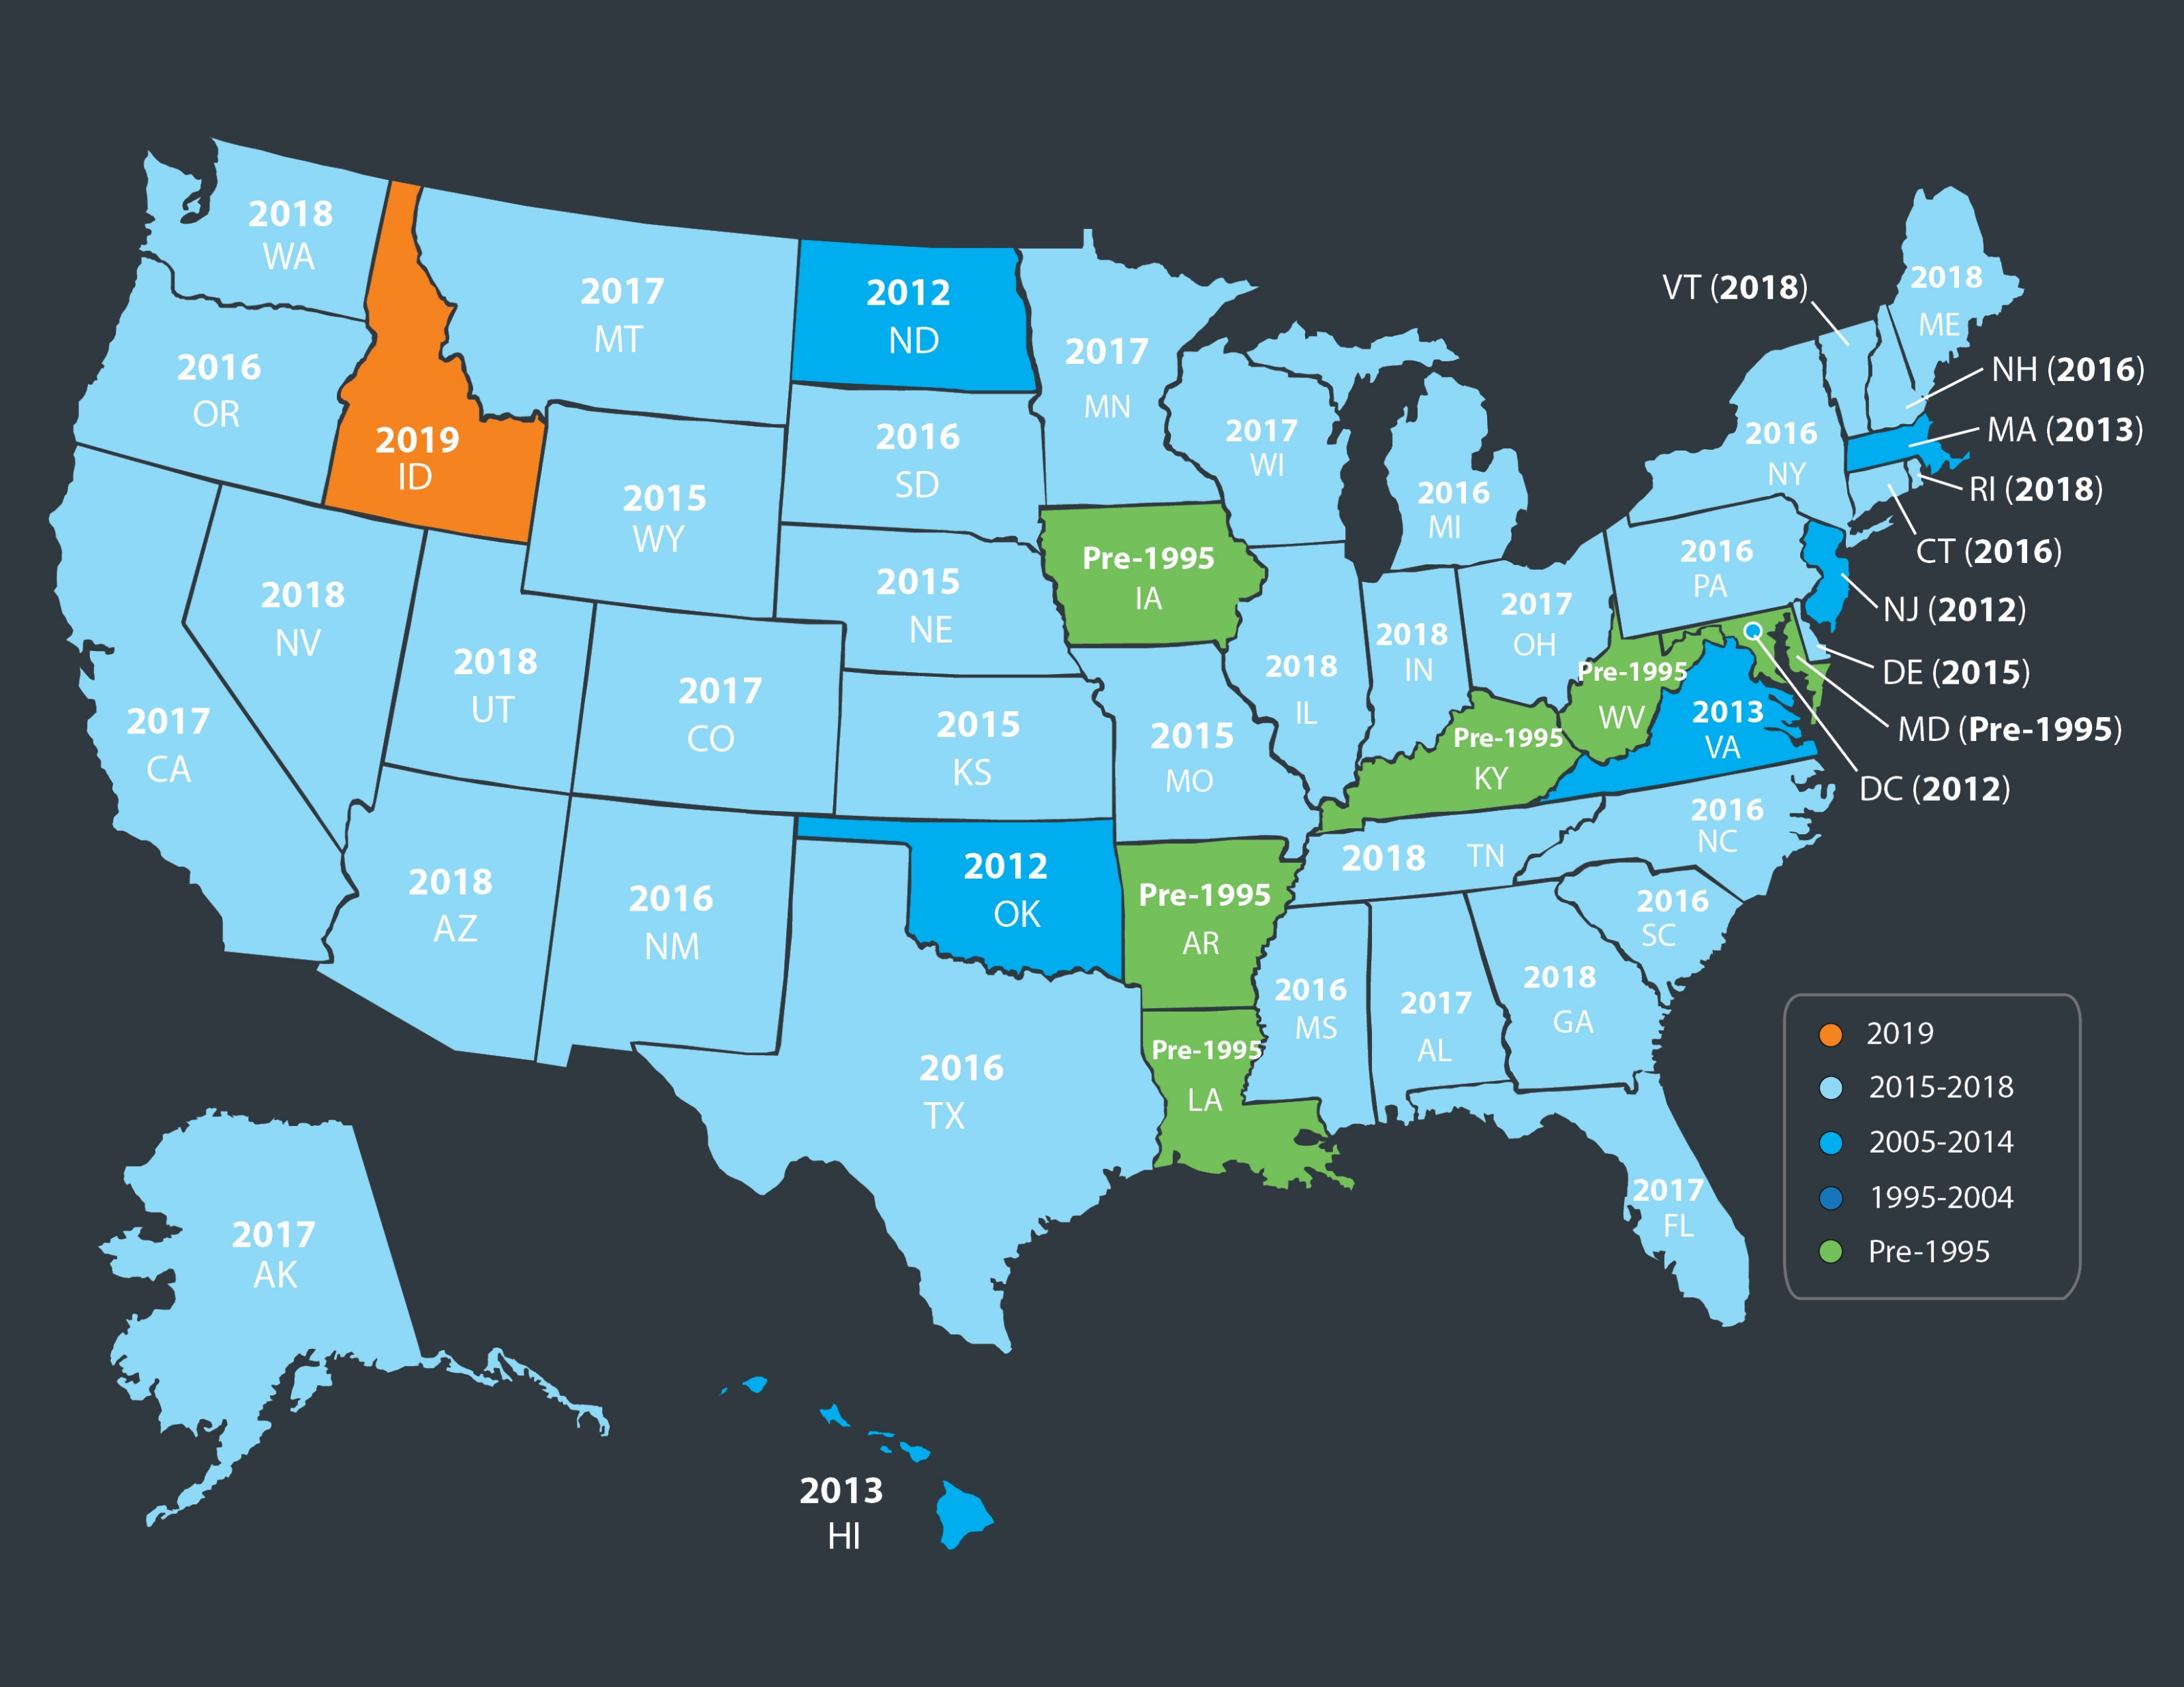
Last Time Housing Was This Affordable
by State
Black Knight
Black Knight
Notes:
https://cdn.blackknightinc.com/

Slide 6
“With supply and demand moving in opposite directions, sellers are clearly gaining the upper hand in the market as buyer competition builds up and prices gain momentum going into the fall.”
Javier Vivas Director of Economic Research at realtor.com
Notes:
https://news.move.com/2020-08-20-Realtor-com-R-Weekly-Recovery-Report-Listing-Prices-Surprise-with-Fastest-Growth-Since-January-2018

Slide 7
The Housing Market’s Recovery
February 1st Baseline = 100
4 components:
Demand, Supply Price & Time on Market
Housing Market Recovery Index
realtor.com
Notes:
https://www.realtor.com/research/housing-market-recovery-index/

Slide 8
Builder Confidence Rebounding!!
78 - Highest reading in the
35-year history of the series
NAHB Housing Market Index
A survey of NAHB members who rate market conditions for the sale of new homes at the present
time and in the next six months as well as the traffic of prospective buyers of new homes.
NAHB
Notes:
http://nahbnow.com/2020/08/builder-confidence-matches-all-time-high-on-record-traffic/

Slide 9
“More home builders are reportedly looking to build long-term relationships with real estate professionals. Builders realize they need real estate pros to bring qualified home shoppers to their builder’s sales offices. And as resale inventory remains tight, agents are realizing they need builders to give their buyers
more options.”
realtor.com
Notes:
https://magazine.realtor/daily-news/2020/08/18/builders-and-agents-necessary-allies

